Slide 1
Search Engines
Chapter 20

Slide 2
Objectives
1
The History and Anatomy of Search Engines
2
Web Crawlers and Scrapers
3
4
Indexing and Reverse Indexing
PageRank and Result Order
5
6
Black Hat Search
Engine Optimization
White-Hat Search Engine Optimization

Slide 3
The History and Anatomy of Search Engines
Section 1 of 6

Slide 4
Google
It’s now a word
The impact of search engines is so pronounced that The Oxford English Dictionary now defines the verb google as
Search for information about (someone or something) on the Internet using the search engine Google.
This shift in the way we retrieve, perceive, and absorb information is of special importance to the web developer since search engines are the medium through which most users will find our websites.

Slide 5
Before Google
Not that long ago
In the days before Google there was no capacity to search the entire WWW. Users would learn about websites by following a link from an email, a message board, or other site.
By 1991 sites dedicated to organized lists of websites started appearing, often created and curated by the Internet Service Providers who wanted to provide added value to their growing clientele.
These web directories categorized websites into a hierarchy and still exist today.

Slide 6
Before Google
Web Directories
To be added to a web directory, one would have to submit a request, often by email.
In curated directories the webmasters would then decide whether or not to list you, and if so, where. Many sites took it upon themselves to censor which sites would be listed.
The Open Directory Project (dmoz.org) has a more open philosophy.

Slide 7
Before Google
Early crawlers
In 1993 web crawlers, the first component of search engines, started appearing.
These crawlers could download a page and parse out all the links to other pages (backlinks).
Meanwhile, in 1996, graduate students at Stanford, Lawrence “Larry” Page, and Sergey Brin began working on a crawler. They incorporated as Google Inc. in 1998, and by June 2000 Google had grown their index to over 1 billion URLs (by 2008 it was 1 trillion).

Slide 8
Search Engine Overview
Lots of components
Search engines consist of several components:
Input agents: web crawlers surf the WWW requesting and downloading web pages
Database engine: manages the URLs and the agents in general
The query server: handles requests from end users
In practice, these components are distributed although conceptually they can be thought of as services on the same machine

Slide 9
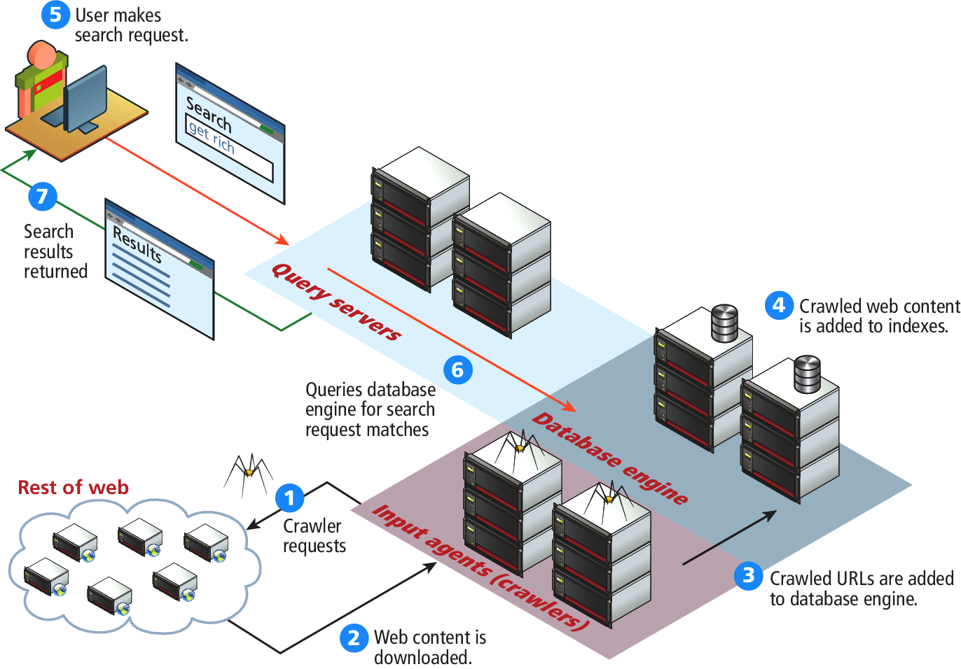
Search Engine Overview
Lots of components

Slide 10
Web Crawlers and Scrapers
Section 2 of 6

Slide 11
Crawlers
Spiders, robots, wanderers
Web crawlers refer to a class of software that
downloads pages
identifies the hyperlinks, and
adds links to a database for future crawling
A crawler can be written to be autonomous, so that it populates its own list of fresh URLs to crawl, but is normally distributed across many machines and controlled centrally.

Slide 12
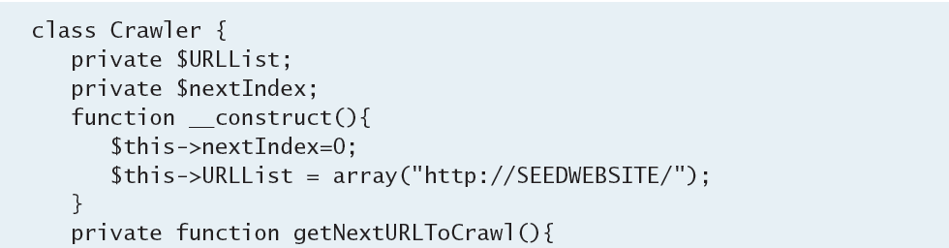
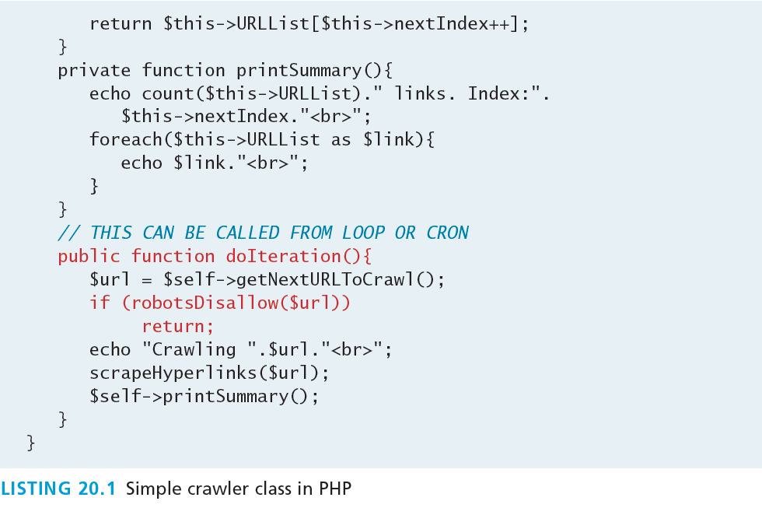
Crawlers
Doesn’t do much by itself…

Slide 13
Crawlers
Be Polite!
In the early days of web crawlers there was no protocol about how often to request pages, or which pages to include, so some crawlers requested entire sites at once, putting stress on the servers.
Martijn Koster, the creator of ALIWEB, drafted a set of guidelines enshrined as the Robots Exclusion Standard that help webmasters block certain pages from being crawled and indexed

Slide 14
Robots Exclusion Standard
Be Polite!
The Robots Exclusion Standard is implemented with plain text files named robots.txt stored at the root of the domain.
Robots.txt has two syntactic elements
user-agent we want to make a rule for (the special character * meansall agents)
One Disallow directive per line to identify patterns.
Regular expressions are not supported!!

Slide 15
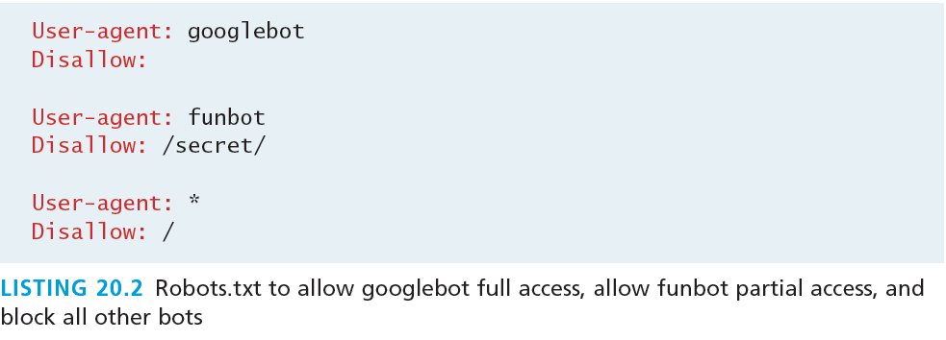
Robots Exclusion Standard
Robots.txt
The Robots Exclusion Standard is not a layer of authentication or security.
Some malicious bots will not obey the directives and purposefully seek out materials specifically disallowed in robots.txt.

Slide 16
Prioritization
Don’t download the entire site at once!
Another outcome of the politeness principle are techniques to prevent hammering the same serve with serial requests.
Prioritization builds on this latter principle and goes further by ranking the uncrawled URLs, using techniques like PageRank
A combo of PageRank and a timestamp of the last time a domain was accessed is the start of a prioritization policy.

Slide 17
Scrapers
“Readers” of my website
Scrapers are programs that identify certain pieces of information from the web to be stored in databases.
Sometimes combined with Crawlers. There are several classes of Scraper:
URL Scrapers
Email Scrapers
Word Scrapers
Media Scrapers

Slide 18
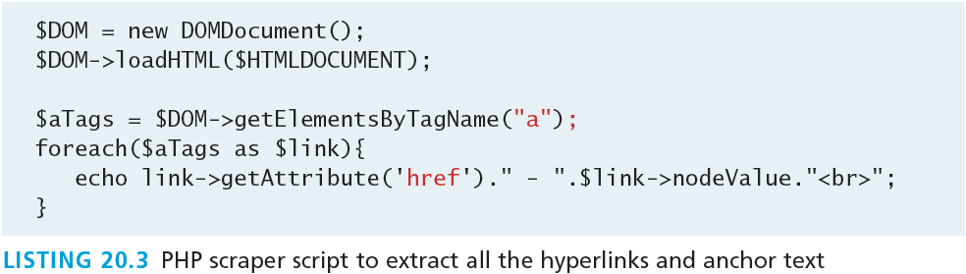
URL Scrapers
Links: The “threads of the web”
URL Scrapers identify URLs inside of a page by seeking out all the <a> tags and extracting the value of the href attribute. This can be done through string matching, seeking the <a> tag, or more robustly by parsing the HTML page into a DOM tree

Slide 19
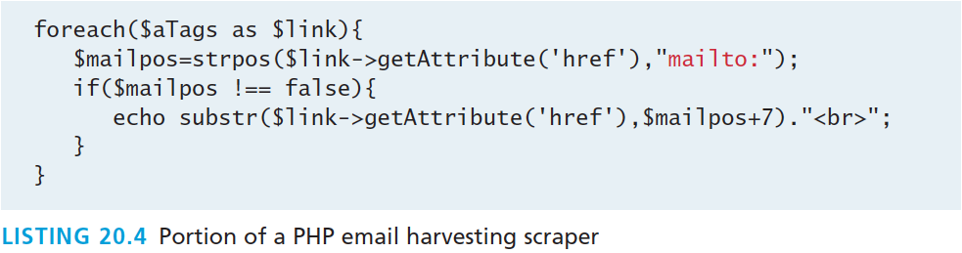
Email Scrapers
Not necessarily evil
Email scrapers harvest email accounts by seeking out mailto: in the href attribute of a link.
A slight modification of our URL Scraper is all that’s needed.

Slide 20
Word Scrapers
That which allows us to search
A Word scraper may want to parse out is all of the text within a web page.
Words are the most difficult content to parse, since the tags they appear in reflect how important they are to the page overall.
Words in a large font are surely more important than small words at the bottom of a page.
Words that appear next to one another should be somehow linked while words that are at opposite ends of a page or sentence are less related.

Slide 21
Indexing and Reverse Indexing
Section 3 of 6

Slide 22
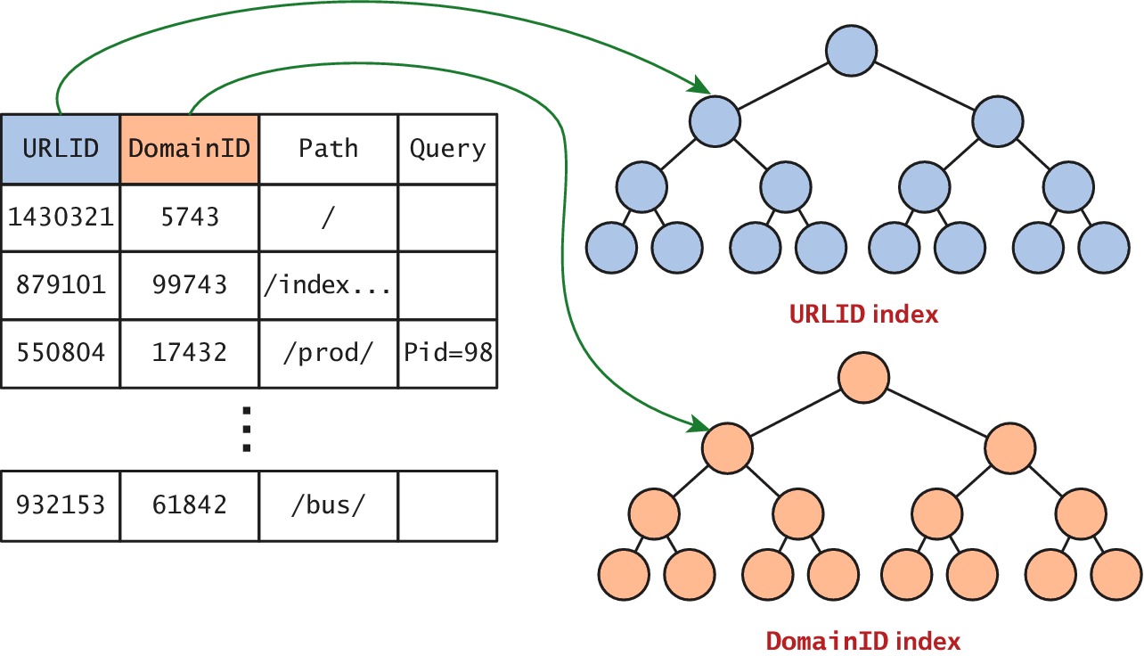
Indexing and Reverse Indexing
That which makes trillion URL searches possible
To understand indexing (as we saw in Chapter 11), consider what a crawler and a scraper might identify from a web page and how they might store it.

Slide 23
Indexing and Reverse Indexing
That which makes trillion URL searches possible
A reverse index essentially indexes the words, rather than the URLs.
The mechanics of how this is done are not standardized, but generally word tables are created (for every word found in pages) so that each word can be referenced by a unique integer, and indexes of these references can be built for faster searches.
Since there are tens of thousands of words, and each word might appear in millions of web pages, the demands on these indexes far exceed what a single database server can support.

Slide 24
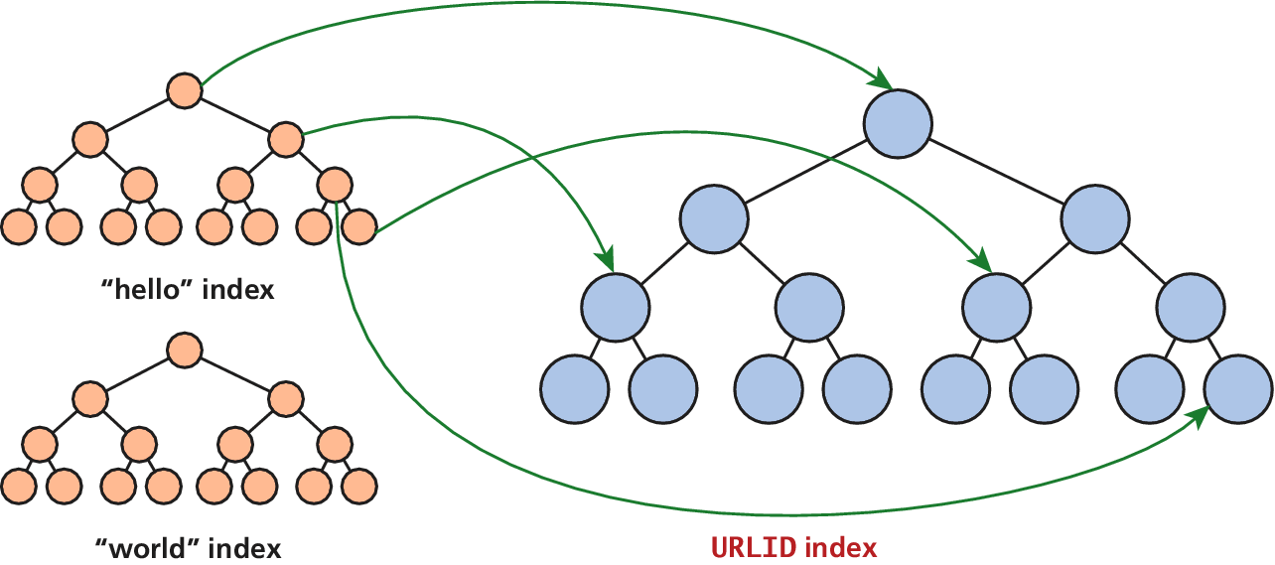
Indexing and Reverse Indexing
That which makes trillion URL searches possible

Slide 25
PageRank and Result Order
Section 4 of 6

Slide 26
PageRank
Bringing order to big data
PageRank is an algorithm, published by Google’s founders in 1998.
According to the authors, PageRank is
a method for computing a ranking for every web page based on the graph of the web.
The graph of the web being referred to looks at the hyperlinks between web pages, and how that creates a web of pages with links.
Sites with thousands of backlinks are surely more important than sites with only a handful of backlinks

Slide 27
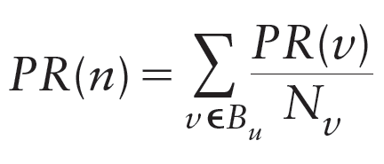
PageRank
What, there’s math?
The simplified definition of a site n’s PageRank is
PR(n), is determined by collecting every page v that links to n (v ε B_{u}), and summing their PageRanks PR(v) divided by the number of links out (N_{v}).

Slide 28
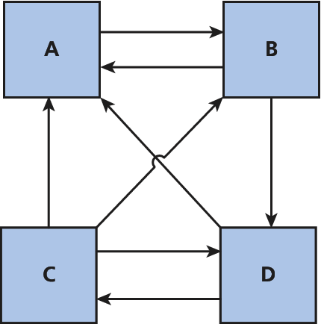
PageRank
An example
To begin, assign the default rank to all pages:
PR(A) = PR(B) = PR(C) = PR(D) = ¼

Slide 29
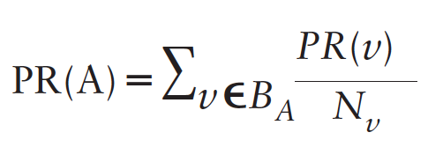
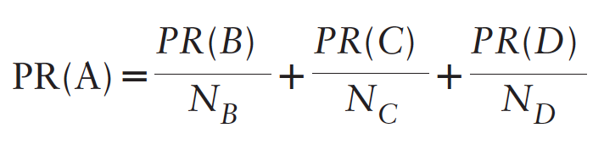
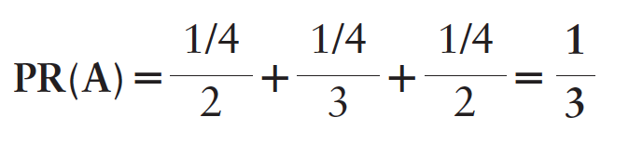
PageRank
An example
Calculate the updated PageRank for A.

Slide 30
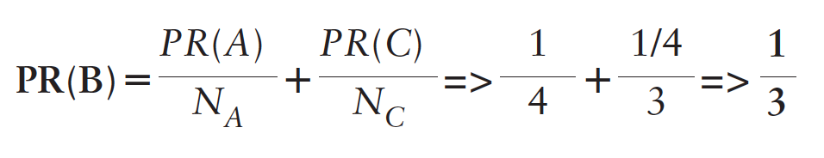
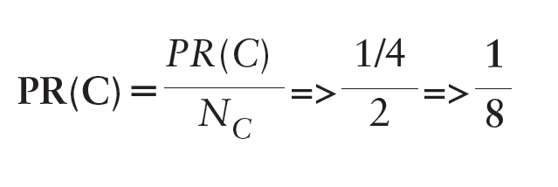
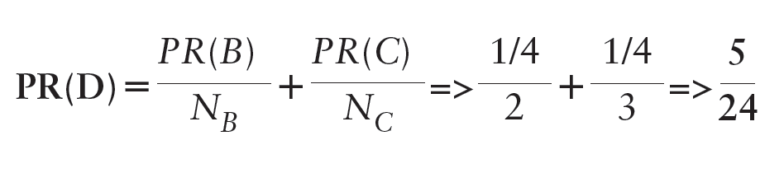
PageRank
An example
Calculate the updated PageRank for the others

Slide 31
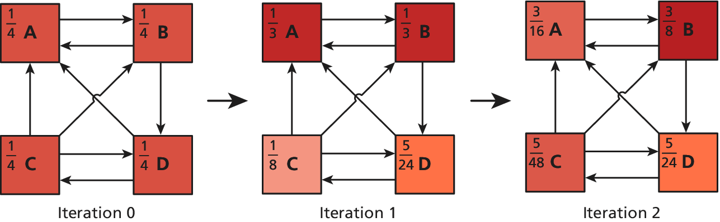
PageRank
Visualized

Slide 32
PageRank
Visualized
Modern ranking algorithms take much more into account than simple backlinks.
Search History
Geographic Location
Authorship
Freshness of the pages
Other inputs…

Slide 33
White-Hat Search Engine Optimization
Section 5 of 6

Slide 34
Search Engine Optimization
White-Hat
Search engine optimization (SEO) is the process a webmaster undertakes to make a website more appealing to search engines, and by doing so, increases its ranking in search results for terms the webmaster is interested in targeting.
For many businesses the optimization of their website is more important than the site itself.
Sites that appear high in a search engine’s rankings are more likely to attract new potential customers, and therefore contribute to the core business of the site owner.

Slide 35
Search Engine Optimization
White-Hat
An entire area of research into SEO has risen up and can be broken down into two major categories:
White-hat SEO that tries to honestly and ethically improve your site for search engines, and
Black-hat SEO that tries to game the results in your favor.

Slide 36
Title Tags
White Hat Technique
The <title> tag in the <head> portion of your page is the single most important tag to optimize for search engines.
The content of the <title> tag is how your site is identified in search engine results as shown
make it unique on each page of your site
Include enough keywords to make it relevant

Slide 37
Meta Tags
White Hat Technique
Early search engines made significant use of meta tags, since indexing meta tags was less data-intensive than trying to index entire pages.
Description
Keywords
Robots
http-equiv

Slide 38
Meta Tags
White Hat Technique
The description meta tag contains a human-readable summary of your site.
<meta name="description" content="The companion site for the upcoming textbook Fundamentals of Web Development from Pearson. Fundamental topics like HTML, CSS, JavaScript and" />
The keywords meta tag allows a site to summarize its own keywords (normally ignored nowadays)
<meta name=”keywords" content=”Web Development, HTML5, CSS, JavaScript, PHP, MySQL, LAMP, Security, Search Engines, … " />

Slide 39
Http-Equiv Meta Tags
White Hat Technique
Tags that use the http-equiv attribute can perform HTTP-like operations like redirects and set headers.
To indicate that a page should not be cached:
<meta http-equiv="cache-control" content="NO-CACHE">
To redirect to http://funwebdev.com/destination.html after five seconds.
<meta http-equiv="refresh" content=" 5;URL=http://funwebdev.com/destination.html">

Slide 40
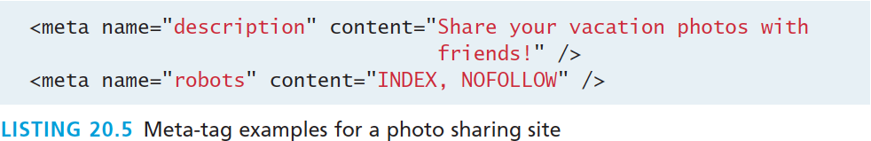
Robot Meta Tags
White Hat Technique
We can control some behavior of search engines through meta tags with the name attribute set to robots. The content for such tags are a comma-separated list of INDEX, NOINDEX, FOLLOW, NOFOLLOW
To include a description and tell robots to index the site, but not to count any outbound links toward PageRank algorithms:

Slide 41
URLs
White Hat Technique
Search engines must by definition download and save URLs since they identify the link to the resource.
Bad SEO URLs
work just fine for programs but cannot be read by humans.
/products/index.php?productID=71829
This can be improved by adding
descriptive path components and
descriptive file names

Slide 42
Good URLs
White Hat Technique
If product 71829 is an air filter, for example, then a URL that would help us identify that this is a product in a category would be
/products/AirFilters/index.php?productID=71829
A step further would be to add the name of the filter in the URL in place of the product’s internal ID.
/products/AirFilters/BudgetBrandX100/
Vs the original
/products/index.php?productID=71829

Slide 43
Site Design
White Hat Technique
Sites that rely heavily on JavaScript or Flash for their content and navigation will suffer from poor indexing.
If your site includes a hierarchical menu, you should nest it inside of <nav> tags to demonstrate semantically that these links exist to navigate your site.
Links in a website can be categorized as:
navigation,
recurring, and
ad hoc.

Slide 44
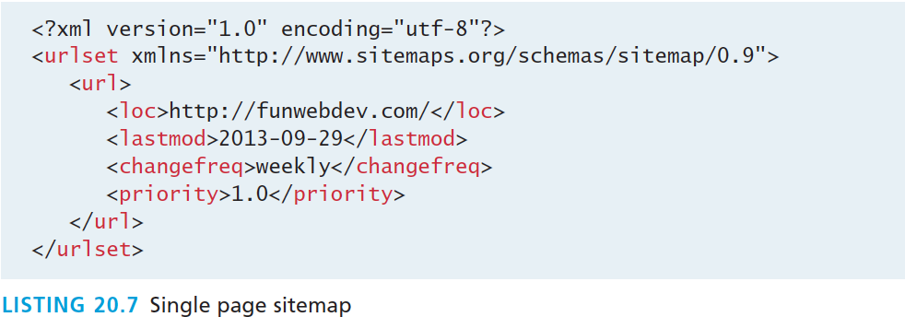
SiteMaps
White Hat Technique
A formal framework that captures website structure is known as a sitemap. Using XML, sitemaps define a URL set for the root item, then as many URL items as desired for the site.

Slide 45
Anchor Text
White Hat Technique
One of the things that is definitely indexed along with backlinks is the anchor text of the link.
In the early web, many links said click here
These days, that use of the anchor text is not encouraged, since it says little about what will be at that URL
Links to a page of services should read “Services and Rates,” since that anchor text has keywords associated with the page.

Slide 46
Images
White Hat Technique
Many search engines now have a separate site to search for images.
The filename is the first element we can optimize, since it can be parsed for words. Rather than name an image of a rose 1.png, we should call it rose.png.
The judicious use of the alt attribute in the <img> tag is another place where some textual description of the image can help your ranking.
Finally, anchor text, like the text in URLs. If you have a link to the image somewhere on our site, you should use descriptive anchor text such as “full size image of a red rose,” rather than generic text “full size.”

Slide 47
Content
White Hat Technique
It seems odd that content is listed as an SEO technique, when content is what you are trying to make available in the first place.
search engines tend to prefer pages that are updated regularly over those who are static
If your website allows users to comment or otherwise write content on your site, you should consider allowing it.
Entire industries have risen up out of the idea of having users generate content

Slide 48
Black-Hat Search Engine Optimization
Section 6 of 6

Slide 49
Black-Hat SEO
Do not use these techniques
Black-hat SEO techniques are popular because at one time they worked to increase a page’s rank.
these techniques are constantly evolving
Google and other search engines may punish or ban your site from their results if you use black-hat techniques

Slide 50
Content Spamming
Black-Hat SEO
Content spamming is any technique that uses the content of a website to try and manipulate search engine results and include:
Keyword Stuffing
Hidden Content
Paid Links
Doorway Pages

Slide 51
Keyword Stuffing
Black-Hat SEO
Keyword stuffing is a technique whereby you purposely add keywords into the site in a most unnatural way with the intention of increasing the affiliation between certain key terms and your URL.
As keywords are added throughout a web page, the content becomes diluted with them.
Meaningful sentences are replaced with content written primarily for robots, not humans.
Any technique where you find yourself writing for robots before humans, as a rule of thumb, is discouraged.

Slide 52
Hidden Content
Black-Hat SEO
Once people saw that keyword stuffing was effective, they took measures to stuff as many words as possible into their web pages.
Soon pages featured more words unrelated to their topic than actual content worth reading.
In response, rather than remove the unwieldy content, many chose to hide useless keywords by making them the same color as the background
This technique is detected and punished

Slide 53
Paid Links
Black-Hat SEO
Buying paid links is frowned upon by many search engines, since their intent is to discover good content by relying on referrals (in the form of backlinks).
Purchased advertisements on a site are not considered paid links so long as they are well identified as such, and are not hidden in the body of a page. Many link affiliated programs (like Google’s own AdWords) do not impact PageRank because the advertisements are shown using JavaScript.

Slide 54
Doorway Pages
Black-Hat SEO
Doorway pages are pages written to be indexed by search engines and included in search results.
Doorway pages are normally crammed full of keywords, and effectively useless to real users of your site.
These doorway pages then link to your home page, which you are trying to boost in the search results

Slide 55
Link spam
Black-Hat SEO
Since links, and backlinks in particular, are so important to PageRank, and how search engines determine importance, there are a large number of bad SEO techniques related to links.
Hidden Links
Comment Spam
Link Farms
Link Pyramids
Google Bombing

Slide 56
Hidden Links
Black-Hat SEO
Hidden links are as straightforward as hidden content.
With hidden links websites hide the color of the link to match the background, hoping that
real users will not see the links.
Search engines, will follow the links, thus manipulating the search engine without impacting the human reader.

Slide 57
Comment Spam
Black-Hat SEO
When you first launch a new website, going out to relevant blogs and posting a link is not a bad idea. After all you want people who read those blogs to potentially follow a link to your interesting site.
Since adding actual comments takes time, many spammers have automated the process and have bots that scour the web for comment sections, leaving poorly auto-written spam with backlinks to their sites.
If you have a comment section on your site, be sure to similarly secure it from such bots, or risk being flagged as a source of comment spam.

Slide 58
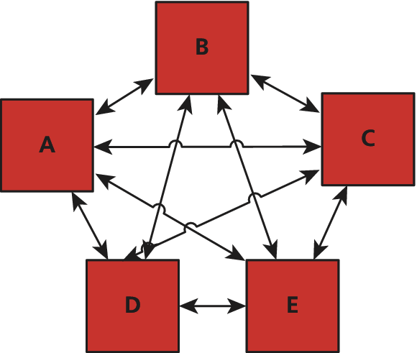
Link Farms
Black-Hat SEO
A link farm is a set of websites that all interlink each other with the intent of sharing any incoming PageRank to any one site with all the sites that are members of the link farm.

Slide 59
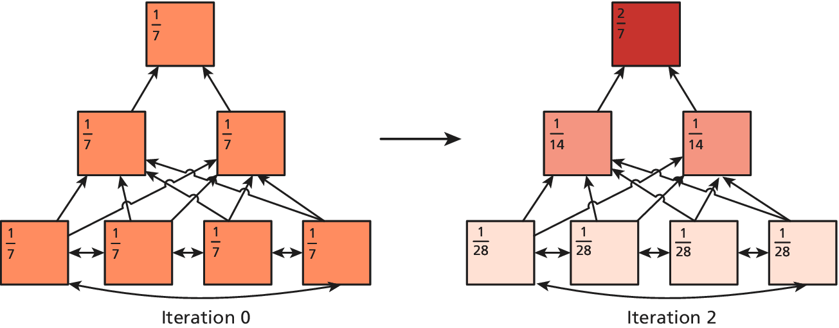
Link Pyramids
Black-Hat SEO
Link pyramids are similar to link farms in that there is a great deal of interlinking. Unlike a link farm, a pyramid has the intention of promoting one or two sites.

Slide 60
Google Bombing
Black-Hat SEO
Google bombing is the technique of using anchor text in links throughout the web to encourage the search engine to associate the anchor text with the destination website.
In 2006, webmasters began linking the anchor text “miserable failure” to the home page of then president George W. Bush. Soon, when anyone typed “miserable failure” into Google, the home page of the White House came up as the first result.

Slide 61
Other Spam Techniques
Black-Hat SEO
Although content and link spam are the prevalent black-hat techniques for manipulating search engine results, there are some techniques that defy simple classification.
Google Bowling
Cloaking
Duplicate content

Slide 62
Google Bowling
Black-Hat SEO
Google bowling is a particularity dirty and immoral technique since it requires masquerading as the site that you want to weaken (or remove) from the search engine
black-hat techniques are applied as though you were working on their behalf. This might include subscribing to link farms, keyword stuffing, commenting on blogs, and more
report the competitors’ website to Google for all the black-hat techniques they employed!

Slide 63
Cloaking
Black-Hat SEO
Cloaking refers to the process of identifying crawler requests and serving them content different from regular users.
A simple script can redirect users if googlebot is the user-agent to a page, normally stuffed with keywords
Serving extra and fake content to requests with a known bot user-agent header can get you banned.

Slide 64
Duplicate Content
Black-Hat SEO
Stealing content to build a fake site has worked in the past, and is often used in conjunction with automated link farms or pyramids. Search engines are starting to check and punish sites that have substantially duplicated content.
To attribute content to yourself use the rel=author attribute. Google has also introduced a concept called Google authorship through their Google+ network to attribute content to the originator.

Slide 65
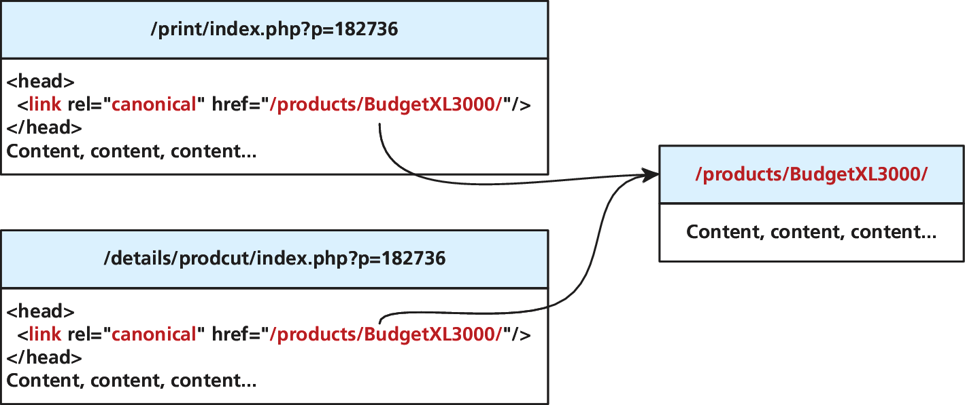
Duplicate Content
Black-Hat SEO
Sometimes you have several versions of a page, for example, a display and print version.
To prevent being penalized, you can use the canonical tag in the head section of duplicate pages to affiliate them with a single canonical version to be indexed.

Slide 66
What You’ve Learned
1
The History and Anatomy of Search Engines
2
Web Crawlers and Scrapers
3
4
Indexing and Reverse Indexing
PageRank and Result Order
5
6
Black Hat Search
Engine Optimization
White-Hat Search Engine Optimization

